Slide 1
Matter
Matter
Pure Substances
Elements
Compounds
Mixtures
Homogeneous
Heterogeneous

Slide 2
Pure substances
Have a constant composition.
Physical and chemical properties are fixed.
Separated by chemical means not physical means.
Two types:
Elements – made up of one type of atom eg Zn, N₂, Kr, S₈, etc
Compounds – made up of two or more atoms chemically combined eg H₂O, AgNO₃, SiO₂, etc

Slide 3
Mixtures
Two or more pure substances combined together.
Physical and chemical properties vary by composition.
Separated by physical means.
Two types:
Homogeneous – uniform in composition eg tap water, air, stainless steel, glass, soft drink etc.
Heterogeneous – variable in composition eg orange juice with pulp, wood, granite rock, soil, etc.

Slide 4
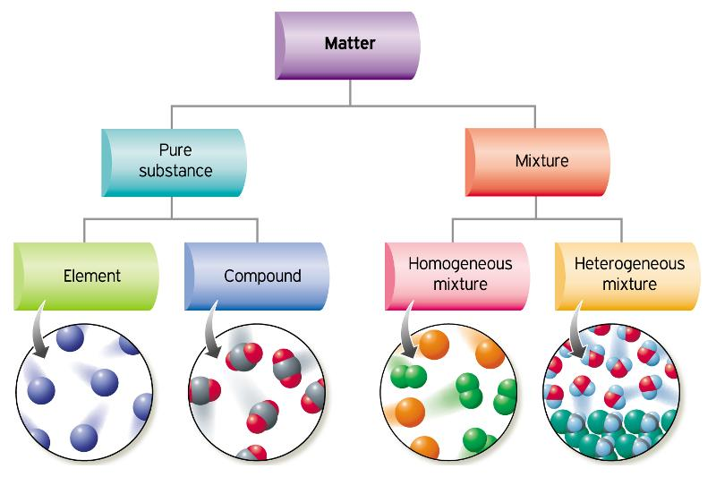
(Andress nd)

Slide 5
Physical properties
Can be determined without changing the chemical composition of the substance eg melting and boiling points, electrical conductivity, density, hardness, etc
Chemical properties
Can be determined by changing the substance into a new substance eg flammability, reactivity with acid, reactivity with oxygen, inertness, etc.
Set 2 qns 2-5

Slide 6
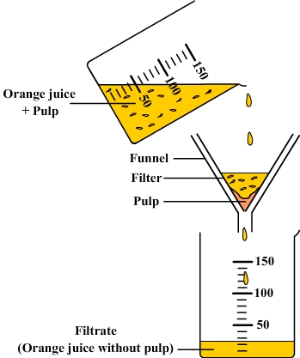
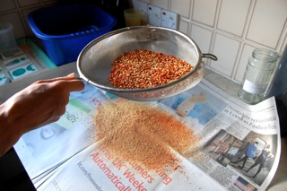
Differences in the physical properties of substances in a mixture can be use to separate them.
Sieving – separation based on particle size. Used for solid mixtures or (large) solids in liquids.
Filtration – separation based on particle size. Used for small solids in liquids.
(Harford 2015)
(NA nd)

Slide 7
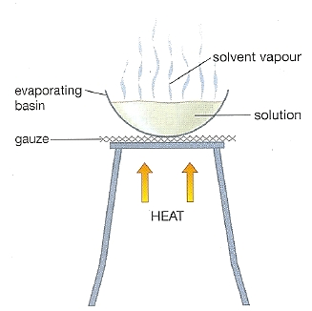
Vaporisation – separation based on differences in boiling points. Used for solid dissolved in a liquid (where only the solid is needed).
(Shinz nd)

Slide 8
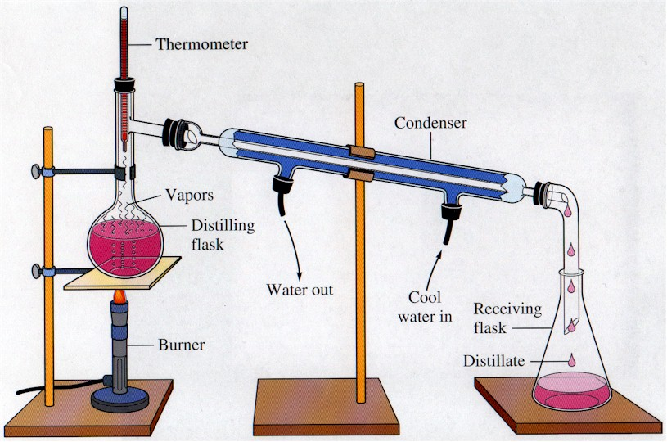
Distillation – separation based on differences in boiling points. Used for solid dissolved in a liquid (where both are needed) or mixture of liquids.
The first liquid to evaporate has the lowest boiling point and is the more volatile component and the other is the less volatile component.
(NA nd)

Slide 9
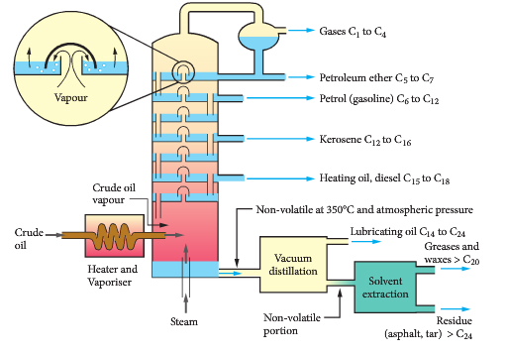
Fractional Distillation – separation based on differences in boiling points. Used for mixtures of liquids.
The fractioning column allows gases of different boiling points to condense at different heights and be tapped off.
(Cengage Learning Australia 2014)

Slide 10
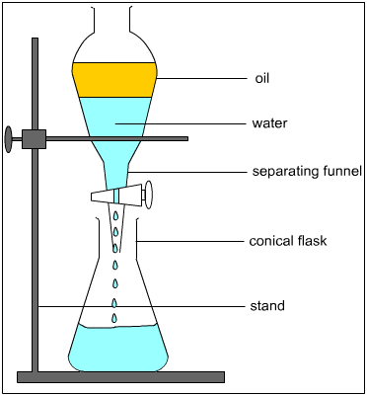
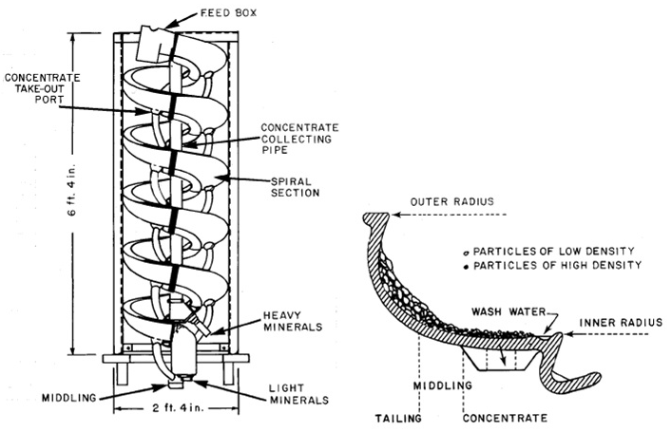
Gravitational Separation – separation based on differences in densities. Used for solid mixtures of similar size or immiscible liquids.
Set 4 qns 1-8
(Learnthings Africa nd)
(Grewal 2015)

Slide 11
Nanotechnology
Nanoparticles are particles that have at least one dimension between 1-100 nanometres (1nm = 1x10⁻⁹m).
Properties of nanoparticles can differ greatly from the bulk material.
Nanothechnology involves the study of nanoparticles and structures as well as their manufacture and potential use.

Slide 12
An example
Carbon nanotubes are made up of carbon atoms (in the form of graphene- a graphite sheet/layer) rolled into tubes. The tubes can be 1 nm in diameter and centimetres long.
Carbon nanotubes conduct electricity and are very lightweight and strong. They can be used in computers, armour, grip pads, camouflage and medical applications.

Slide 13
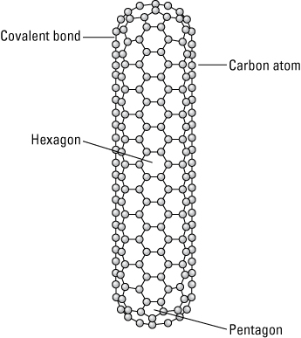
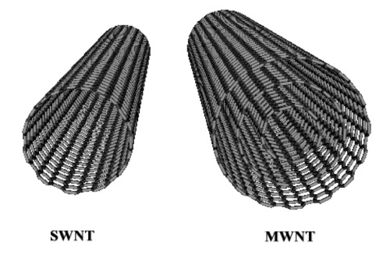
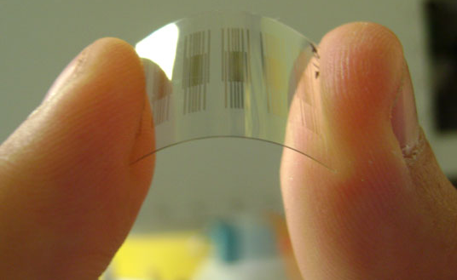
(Pearson 2008)
(Hawk’s Perch Technical Writing 2007)
(Orenstein 2009)

Slide 14
Scanning electron microscopes, scanning tunnelling electron microscopes and atomic force microscopes are used to image and manipulate nanoparticles.
Read Lucarelli p65-68 and complete Set 14 p71 q8, 11-14

Slide 15
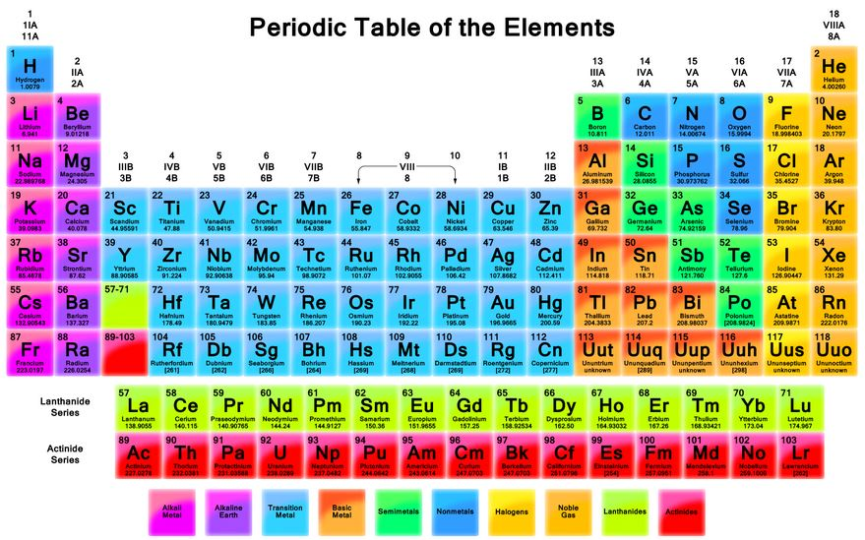
Bonding
Bonding Types
Metallic bonding involves only metals (eg Zn, Ca, Ag, etc).
Ionic bonding involves cations and anions (eg NaCl, Fe₂(SO₄)₃, LiHCO₃, etc)
Covalent bonding involves only non-metals
Covalent bonding occurs in molecular substances (eg H₂O, CO₂, SF₃, etc) and network substances (eg C, SiC, SiO₂, etc)
(NA Tags Archive: Periodic Table 2013)

Slide 16
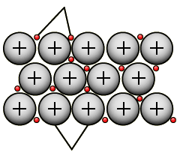
Metallic Bonding
DESCRIPTION
Metallic bonding is the strong electrostatic attraction between the metal cations/nuclei and the delocalised (ie mobile) valence electrons.
Delocalised valence electrons
Positive metallic ions/nuclei
(BBC 2014)

Slide 17
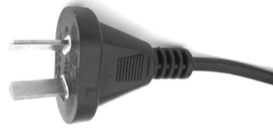
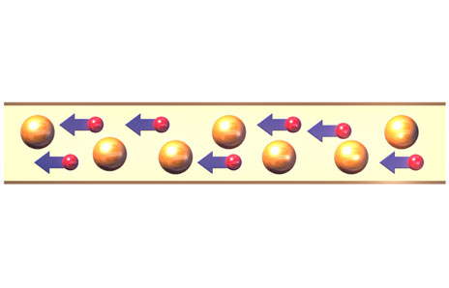
PROPERTIES
Metals conduct electricity. This is due to the mobile, delocalised valence electrons which can carry the electrical charge from one place to the next.
Electricity in
Electricity out

Slide 18
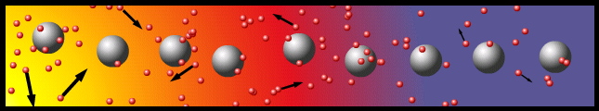
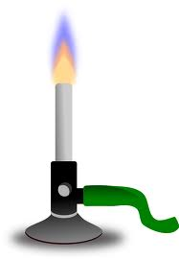
Metals conduct heat. This is because the mobile valence electrons gain heat energy and then are able to ‘bump’ their neighbours and transfer the heat energy efficiently. Heat transfer
Mobile, delocalised
valence electrons
Positive metal
nuclei
Heat energy transfer

Slide 19
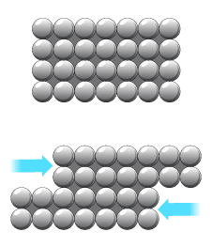
Metals are malleable (can be beaten into sheets) and ductile (can be drawn into wires). This is because as a force is applied to the metal and the positive metal nuclei are pushed closer together, the mobile valence electrons can move in between the nuclei to minimise repulsion.
Mobile, delocalised
valence electrons
Positive metal
nuclei

Slide 20
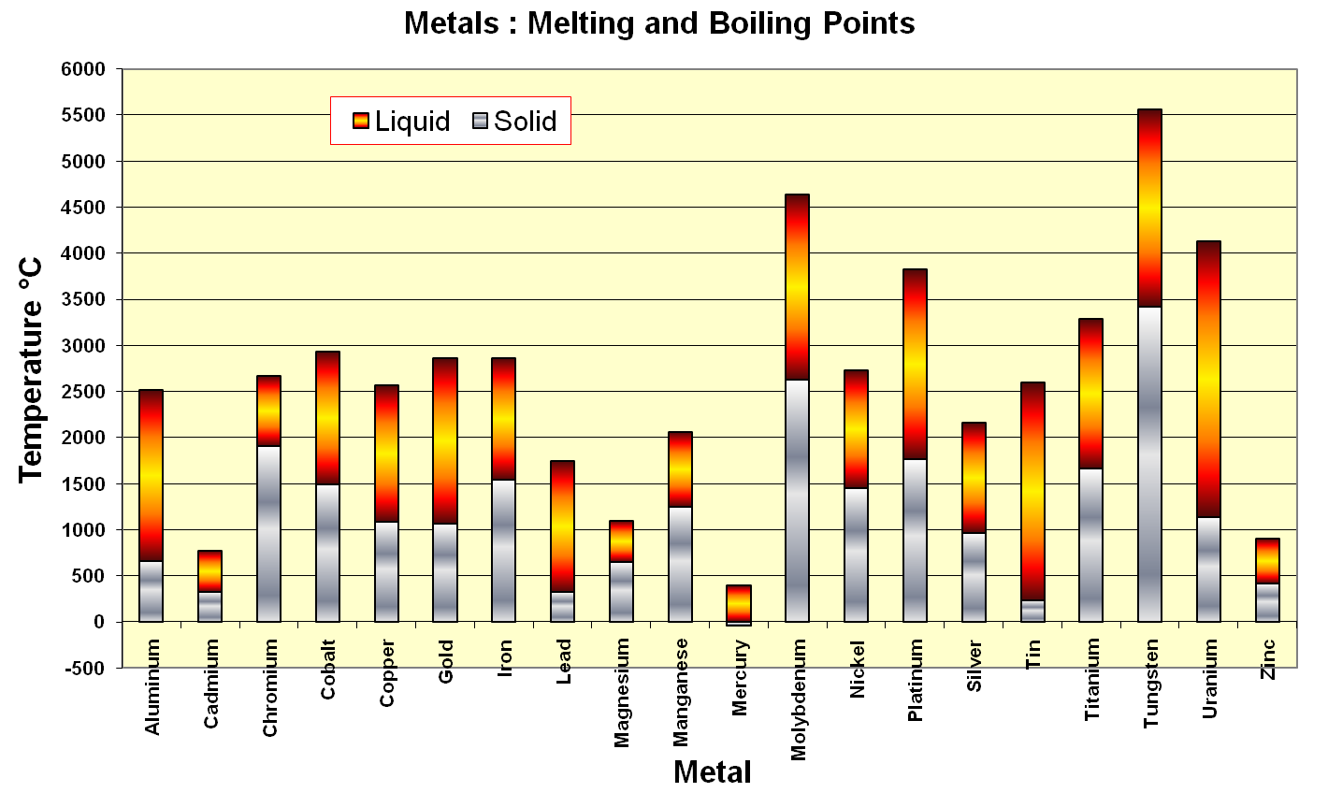
Metals have high melting and boiling points. This is due to the strong electrostatic attraction between the positive metal nuclei and the mobile valence electrons, which requires a lot of energy to overcome.

Slide 21
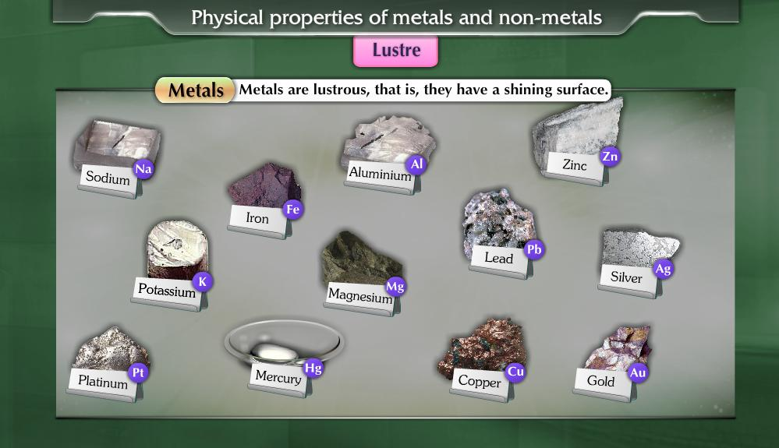
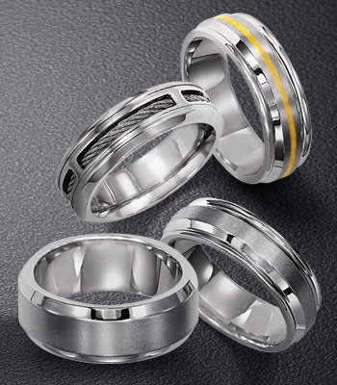
Metals have a high lustre (ie are shiny) due to the interaction of the mobile valence electrons at their surface with incoming light.

Slide 22

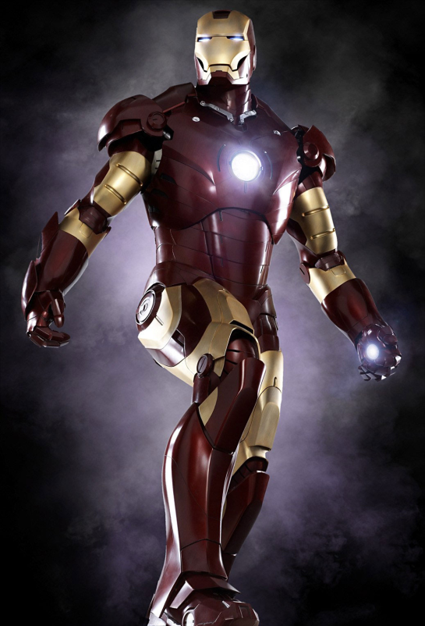
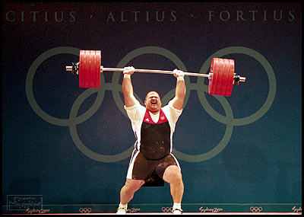
Metals tend to be strong, hard solids due to the strong electrostatic attraction between the positive metal nuclei and the mobile valence electrons. They are also dense solids due to the tightly packed arrangement of the atoms.

Slide 23

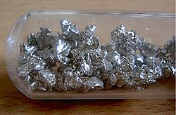
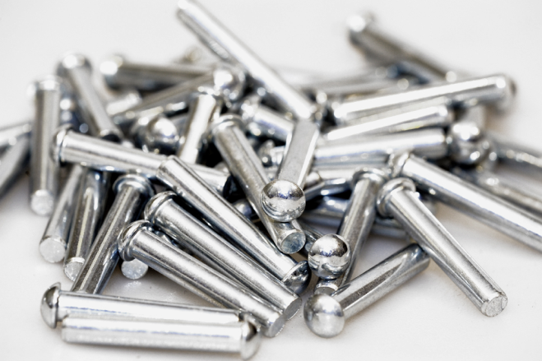
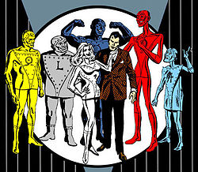
Examples of substances that possess metallic bonding include titanium, zinc, aluminium, calcium and mercury.
Nelson Question Set 3.2 p167

Slide 24
IONIC Bonding
When neutral atoms form ions, they gain or lose electrons to fill their outer shell.
eg sodium atom – electron configuration is 2,8,1 so it gives up one electron to have a full valence shell, forming a Na⁺ ion (2,8).
sulfur atom – electron configuration is 2,8,6 so it gains two electrons to have a full valence shell, forming a S²⁻ ion (2,8,8).

Slide 25
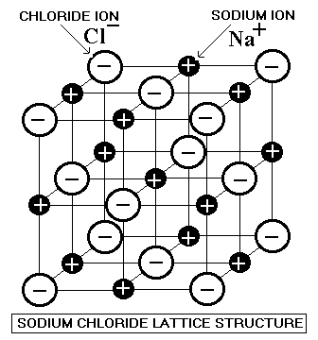
DESCRIPTION
Ionic bonding is the strong electrostatic attraction between the positive cations and negative anions in an ordered, three dimensional lattice.

Slide 26
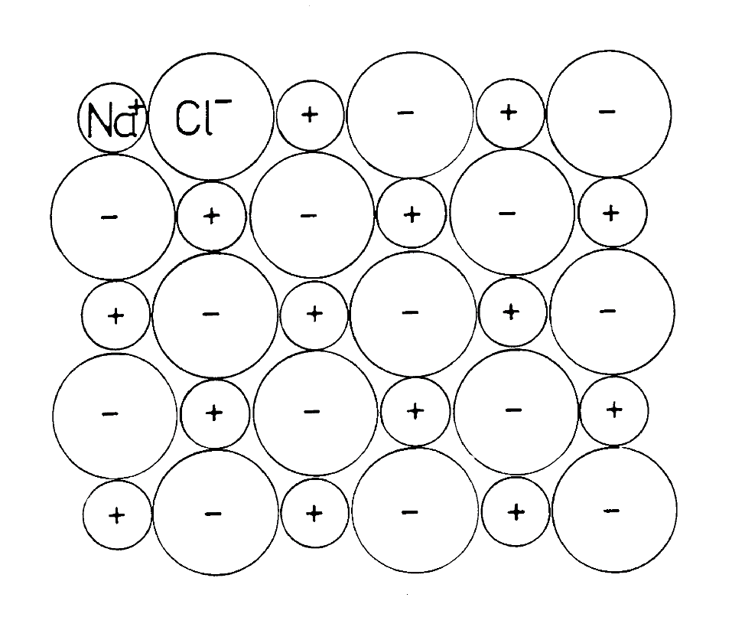

Slide 27
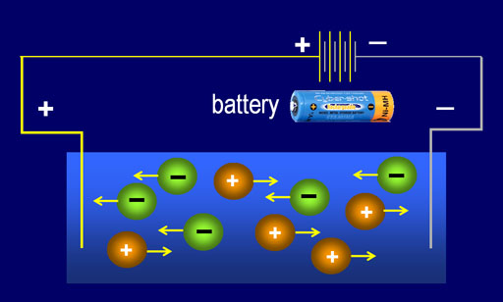
PROPERTIES
Ionic solids do not conduct electricity. This is due to the fact that the ions (charged particles) are not mobile as they held in fixed positions in a lattice.
Ionic substances do conduct electricity when molten (liquid) and/or aqueous (ie a solution) as the ions separate from the lattice and become mobile.

Slide 28
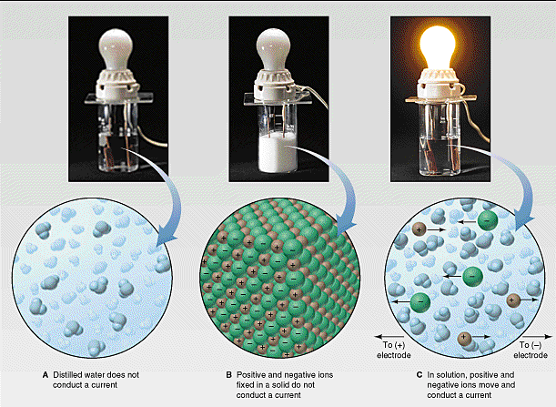

Slide 29
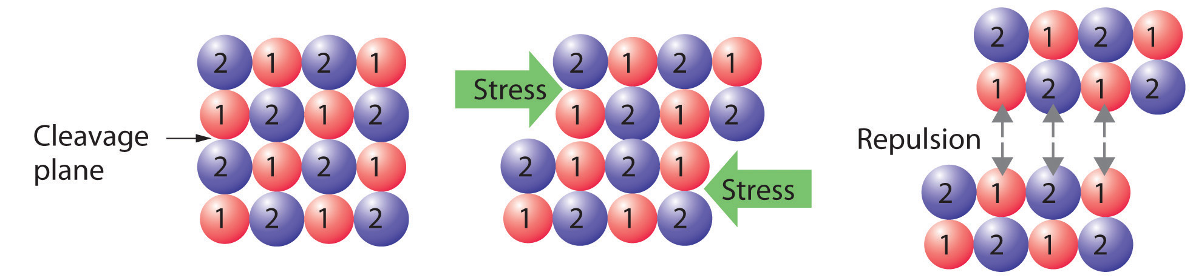
Although ionic substances are hard (due to the strong electrostatic attraction between the oppositely charged ions), they are brittle (ie they shatter when hit). This is because when a force is applied, the ordered lattice is disrupted such that like charged ions move next to each other and repel one another, breaking the lattice apart.

Slide 30
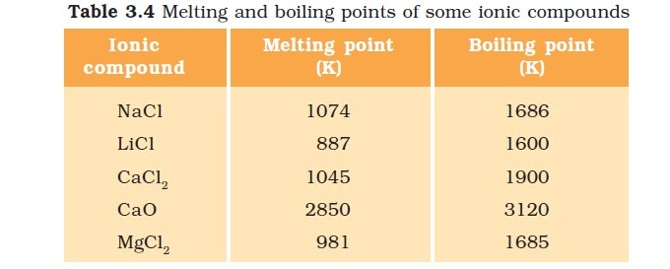
Ionic substances have relatively high melting and boiling points. This is due to the strong electrostatic attraction between the oppositely charged ions, which requires a lot of energy to overcome.

Slide 31
Ionic substances are hard. This is due to the strong electrostatic attraction between the oppositely charged ions making it difficult to disrupt the lattice.

Slide 32
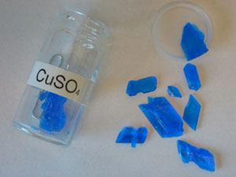
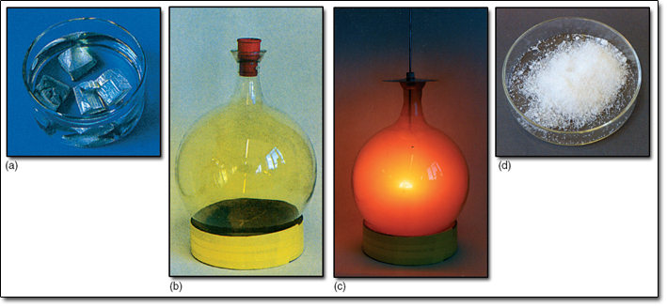
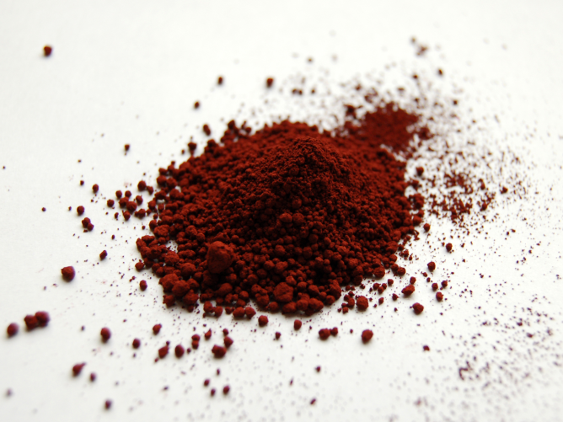
Examples of substances that display ionic bonding include sodium chloride, copper (II) sulfate and iron (III) oxide.
Remember that the formulae of ionic compounds can be determined from the charges on the ions.
Nelson Question Set 3.4 p177

Slide 33
COVALENT Bonding
Description
Covalent bonding is due to the strong electrostatic attraction between the shared valence electrons and the positive nuclei of the atoms involved in the bond. This can occur to form molecules or networks.

Slide 34
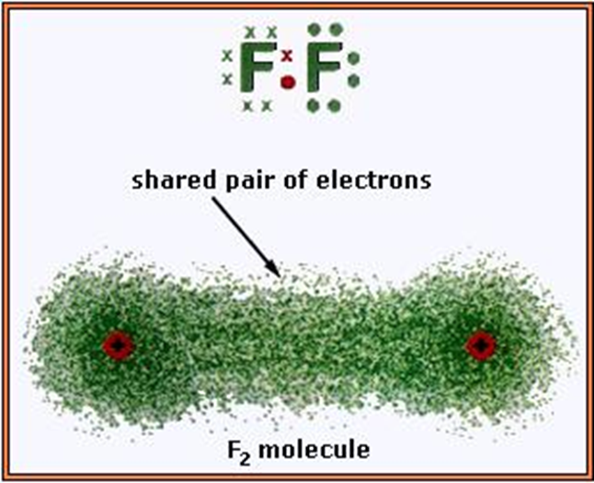
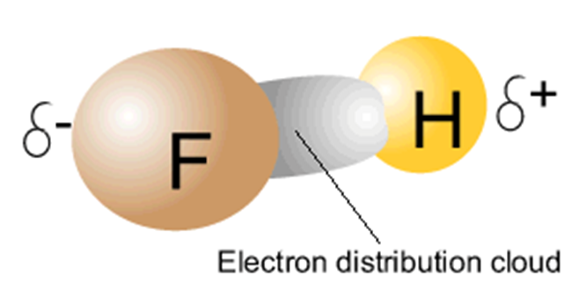
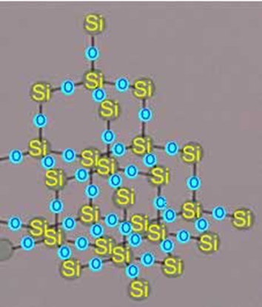
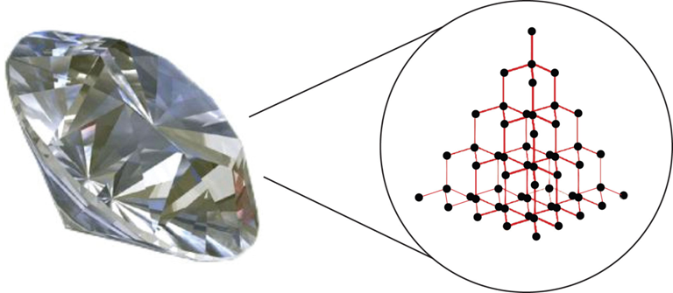

Slide 35
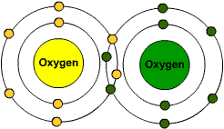
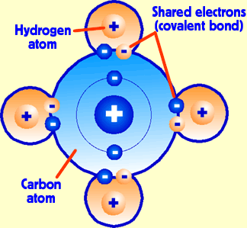
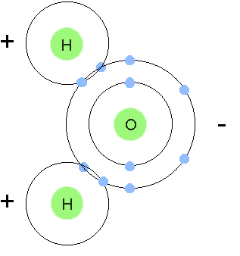
The atoms involved in covalent bonds usually share electrons to gain full valence shells.
The electrons that are shared are fixed in place.

Slide 36
PROPERTIES OF COVALENT MOLECULAR SUBSTANCES
Covalent molecular substances do not conduct electricity in any state. This is due to the fact that although they do possess charged particles (electrons) they are not mobile.
They have low melting and boiling points due to the relatively weak forces between the molecules (ie intermolecular forces), which do not require a lot of energy to overcome.
COVALENT Molecular SUBSTANCES

Slide 37
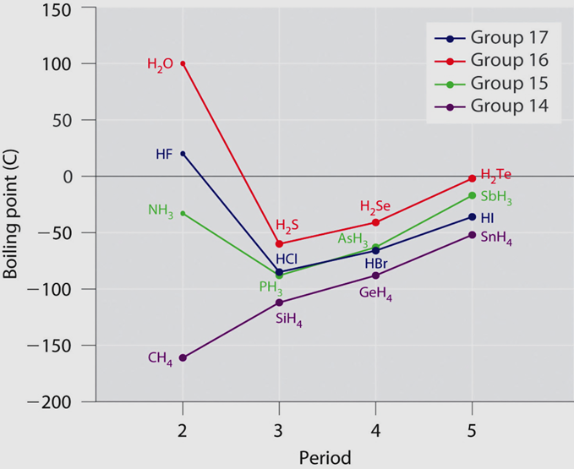

Slide 38
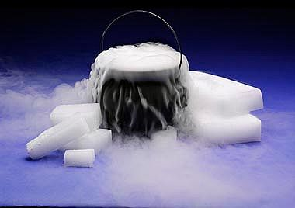

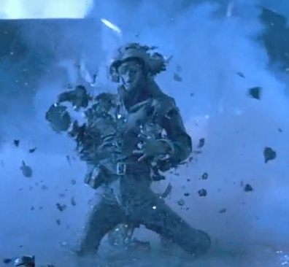
Examples of substances that display covalent molecular bonding include carbon dioxide, methane and nitrogen gas. Liquid nitrogen

Slide 39
COVALENT Network SUBSTANCES
STRUCTURE
Unlike covalent molecular substances where the molecules are discrete (single molecules), in covalent network substances the atoms are bonded to millions of other atoms in an ordered, three dimensional array (network).

Slide 40
PROPERTIES
Covalent network substances do not conduct electricity in any state. All electrons are held in strong covalent bonds so are not mobile.
They have high melting and boiling points due to the strong electrostatic attraction between the positive nuclei and the shared electrons in multiple bonds which requires a lot of energy to overcome.
They are hard solids due to the same reason above.

Slide 41
The exception to these properties is graphite.
Graphite does conduct electricity. Carbon has 4 valence electrons. In graphite each carbon atom is only covalently bonded to three other carbon atoms leaving the fourth valence electron mobile and able to conduct a current.

Slide 42
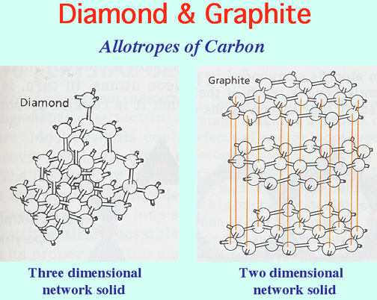
Delocalised, valence electron

Slide 43
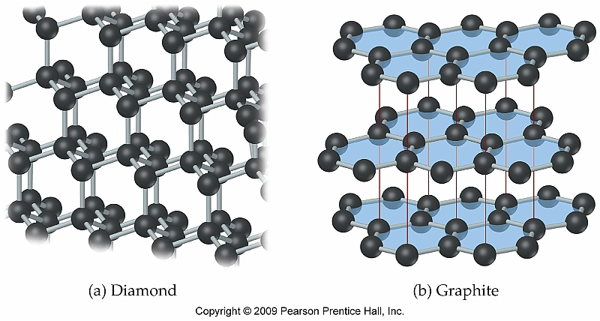
Graphite does have high melting and boiling points. There is a strong electrostatic attraction between the positive nuclei and the shared electrons in multiple covalent bonds which will require a lot of energy to overcome.
Unlike diamond, graphite is a relatively soft solid as the layers can slip over one another.

Slide 44
Graphite has strong covalent bonding within 2-D layers but the electrostatic attraction between the layers is very weak so it is easy for the layers to slide over each other.

Slide 45
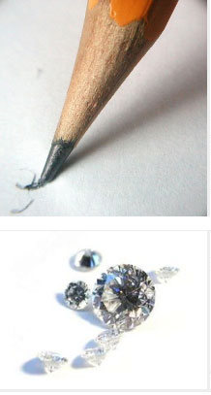

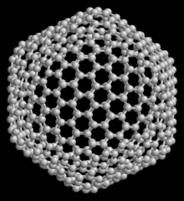
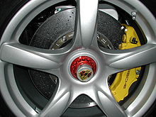
Examples of covalent network substances include diamond, graphite and bucky balls (all allotropes of carbon), silicon dioxide (glass) and silicon carbide.

Slide 46
Allotropes are different structural forms of the same element.
Bibliography
Andress, E. "Elements, Compounds and Mixtures." Blendspace. nd. https://www.blendspace.com/lessons/Q42KangV6W2wEQ/copy-of-elements-compounds-mixtures (accessed February 2015, 2015).
Cengage Learning Australia. Nelson Chemistry Units 1 & 2 for the Australian Curriculum. Cengage Learning Australia Pty Ltd, 2014.
Grewal, Ish. "Introduction to Mineral Processing." Met-Solve Laboratories. 2015. http://met-solvelabs.com/library/articles/mineral-processing-introduction (accessed March 7, 2015).
Harford, R. "How to Dry and Store Rose Hips for Rose Hip Tea." Wild Food Guide to the Edible Plants of Britain. 2015. http://www.eatweeds.co.uk/how-to-dry-store-rose-hips-rosa-canina (accessed February 27, 2015).
Hawk's Perch Technical Writing. "What are Carbon Nanotubes?" Understanding Nano.com. 2007. http://www.understandingnano.com/what-are-carbon-nanotubes.html (accessed March 8, 2015).
Learnthings Africa. "Separating Liquids That Do Not Mix." Learnthings.com. nd. http://learnthings.co.za/content/secondary/Home/Lessons/Science/Chemistry/Grade10/experimen/experimen/separatio/separa_00/default.htm (accessed March 7, 2015).
NA. "Distillation Apparatus." Distillation Apparatus. nd. http://jupiter.plymouth.edu/~wwf/distillation.htm (accessed February 27, 2015).
—. "Mixtures and Solutions." Chemistry. nd. http://www.physics-chemistry-class.com/chemistry/filtration.html (accessed 27 February, 2015).
Orenstein, David. "Cheap, Sensitive Stanford Sensors Could Detect Explosives, Toxins in Water." Stanford News. 2009. http://news.stanford.edu/news/2009/september21/sensor-detect-explosives-092309.html (accessed March 8, 2015).
Pearson, Chris. "Carbon Nanotubes." The Role of Chemistry in History. 2008. http://itech.dickinson.edu/chemistry/?cat=74 (accessed March 8, 2015).
Shinz. "Seperation Techniques." Glogster. nd. http://www.glogster.com/shinz/seperationtechinques/g-6m79h240t7bg67oq0u2gua0 (accessed February 27, 2015).

